Slide 1
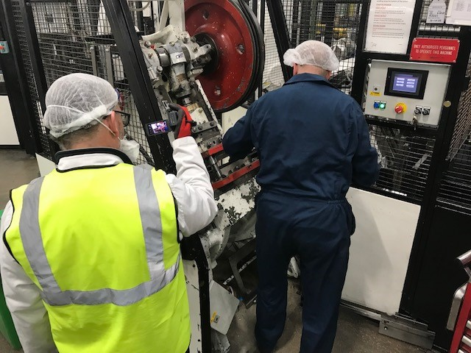
Market Sector:
Technology Theme:
INDUSTRIAL GROWTH
BUSINESS TRANSFORMATION
EVIOSYS – TOOL CHANGE AUDIT
“Our project is not recreating the wheel, but working with MTC has allowed us to take change over activity to the next level while reinforcing the basics. The involvement of our wider team has been positively received and we’ve taken the learning opportunities along the way.”
Mike Wise, Plant Manager – Eviosys, Mansfield
THE CHALLENGE
MTC’S SOLUTION
The Eviosys sites at Mansfield and Carlisle produce tins of various design for the food industry with relatively short production runs.
Separate lines produce the tin body and lids, current time taken to change, set and verify the lines take around 5 days on average (with 24hr working). Capacity impact in August 2022; 11 changes across 24 lines resulting in 55 days lost working time due to changeover.
Impact – customer delivery frequently compromised, along with overtime costs and pressure on production personnel.
The project trained eight Eviosys personnel to capture and analyse current set up procedures across multiple lines at Mansfield and Carlisle through use of video capture (GoPro).
Training included covering the lean principles of SMED (Single Minute Exchange of Die), 8 Wastes, the use of video to capture and analyse current changeover procedures and the use of SWCT (Standardised Work Combination Tables) to graphically illustrate the time taken for each changeover element.
The activity relied on a team-based approach, with Eviosys personnel ‘learning by doing’ through application of lean principles and following a PDCA (Plan Do Check Act cycle) discipline.

Slide 2
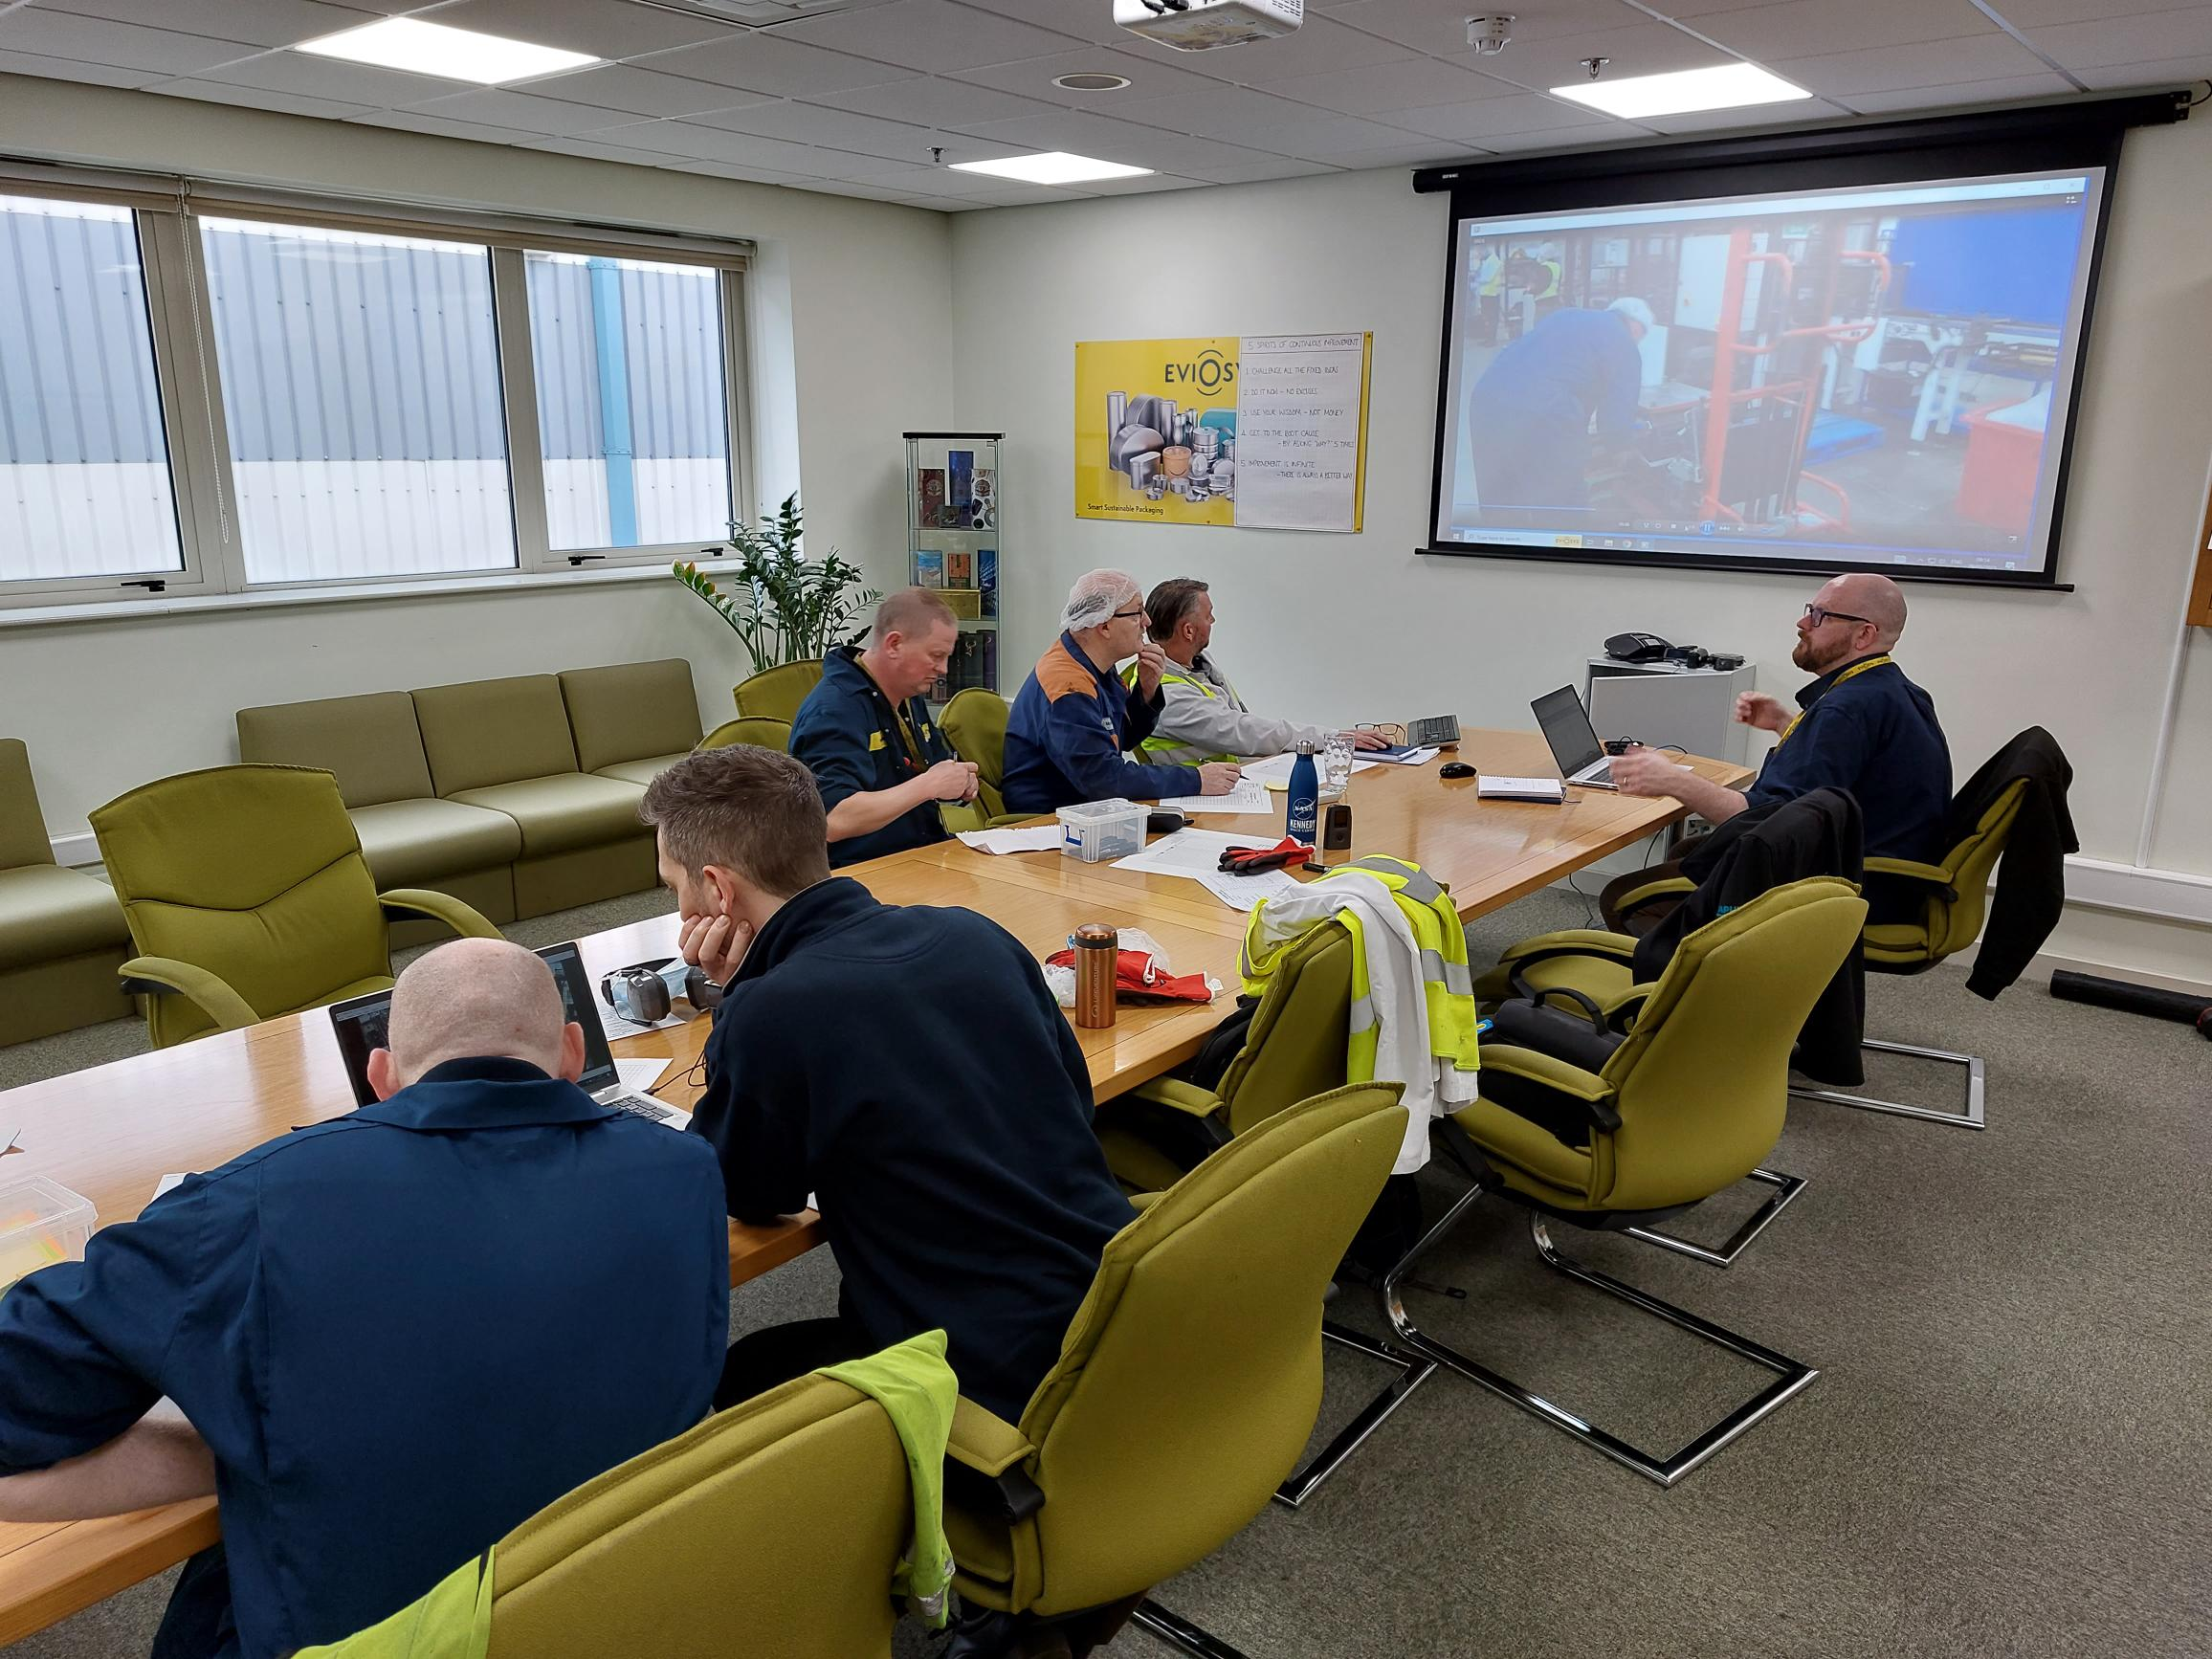
THE OUTCOME
BENEFITS TO THE CLIENT
Eight separate changeover processes across tin lid and tin body lines were observed, recorded, and analysed.
A total of 60 separate waste items were identified by the Eviosys teams, and countermeasures were brainstormed. From these, 51 countermeasures were identified as priority through an ease/impact assessment.
In addition, 23 opportunities for technology adoption to improve the changeover process were identified.
Application of SMED and 8 Wastes lean training resulted in the Eviosys teams identifying improvements that have the potential to reduce current set up times by up to 44%.
Reviewing opportunities to apply technology identified potential time savings of a further 39%.
Reviewing the impact on the full value stream (warehousing, inventory, use of temporary workers etc.) the potential for applying the identified improvements is an estimated annual cost saving of £270,000.
“With the help of the MTC, we’ve been able to complete our project in good order while embedding good practices and demonstrating tangible EHS as well as operational and financial benefits.”
Mike Wise, Plant Manager – Eviosys, Mansfield
00%
00
£
0.0m
Insert Statistic
Insert Statistic
Insert Statistic
Manufacturing Technology Centre,
Pilot Way, Ansty Park,
Coventry, CV7 9JU
Tel: +44 (0)2476 701 600
www.the-mtc.org

