Slide 1
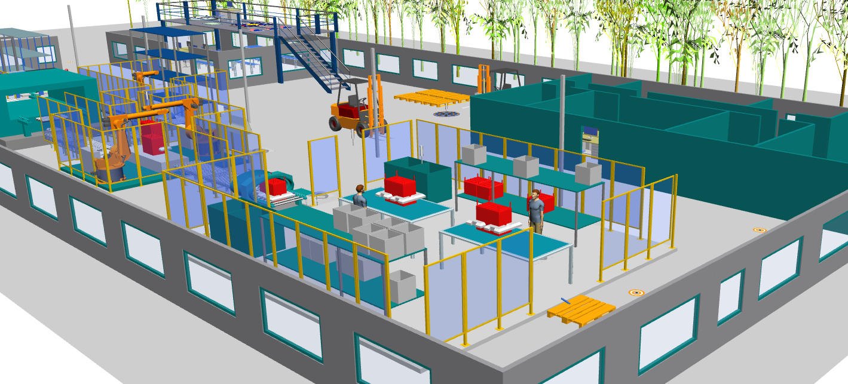
Market Sector:
Technology Theme:
POWER & ENERGY
DIGITAL ENGINEERING & AUTOMATION
FACTORY DESIGN & DEVELOPMENT
VIRTUAL DESIGN & OPTIMISATION
HYDROGEN FUEL CELLS & ELECTROLYSERS PRODUCTION
Strategic collaboration between MTC and AMRC to design a reconfigurable factory for scalable production of both fuel cells and electrolysers.
THE CHALLENGE
SOLUTIONS
The hydrogen economy is experiencing a dynamic transformation, with a swift evolution in manufacturing processes for fuel cells and electrolysers, reflecting the ongoing advancements and innovations in this rapidly expanding industry.
Manufacturers are tasked with producing both fuel cell and electrolyser products to offer end-to-end green hydrogen systems to end-users.
The challenge is to design a factory system that exploits the commonalities between fuel cells and electrolysers and incorporates the required level of reconfigurability to meet varying annual demand for both fuel cells and electrolysers.
A secondary challenge is evaluating how digital manufacturing solutions’ capabilities can support the effectiveness of these reconfigurable factory systems.
Assessment of commonality amongst fuel cell and electrolyser assembly technologies to characterise the opportunities for reconfigurable factory systems
Design and simulation of automated cell stacking process using robotics solution to incorporate required flexibility
Modelling and virtual evaluation of a complete bi-product manufacturing factory system across scale-up scenarios, benchmarked against systems dedicated individually to fuel cells or electrolysers
Production system design optimisation to increase annual throughput and overall equipment effectiveness
Assessment of potential improvement from adopting an operational digital twin to adapt production plans and maintenance schedules

Slide 2
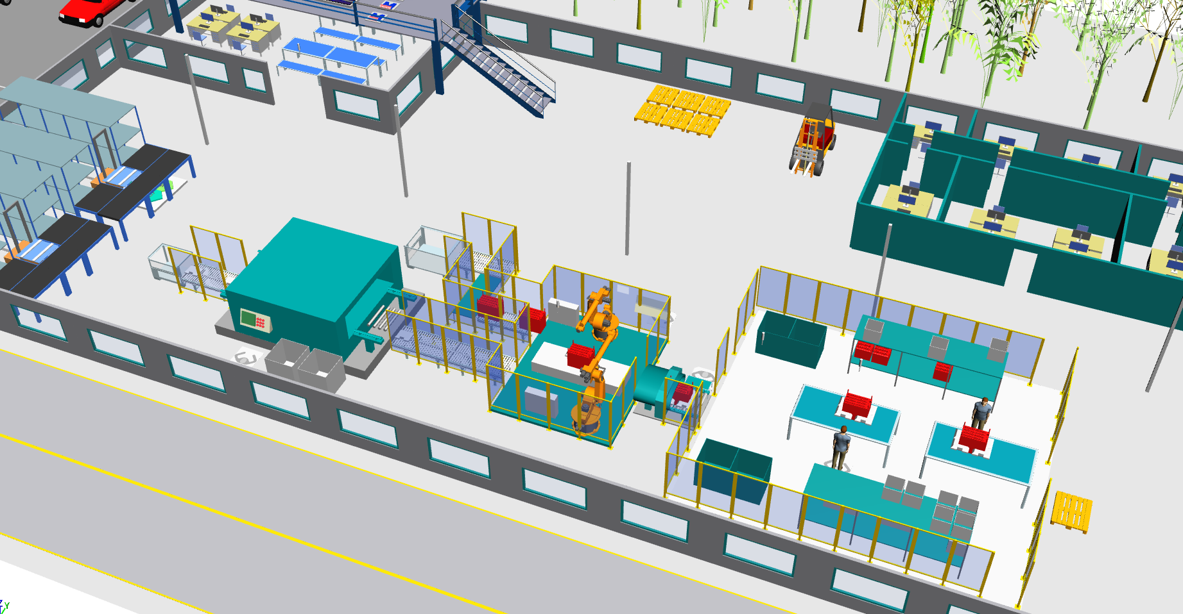
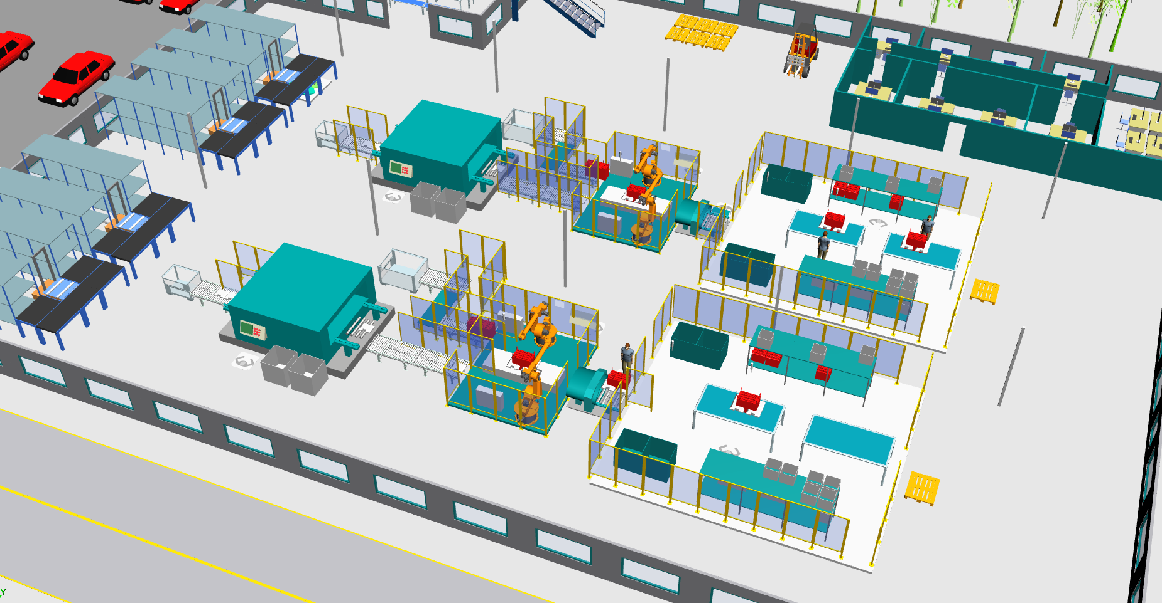
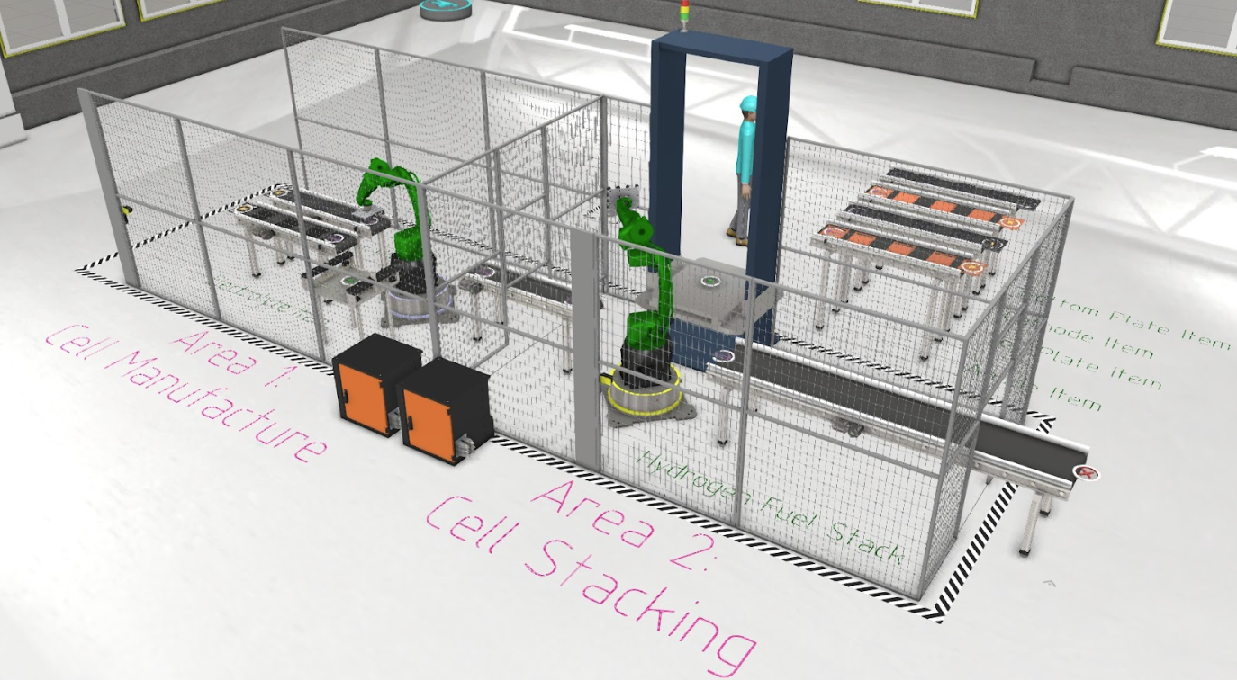
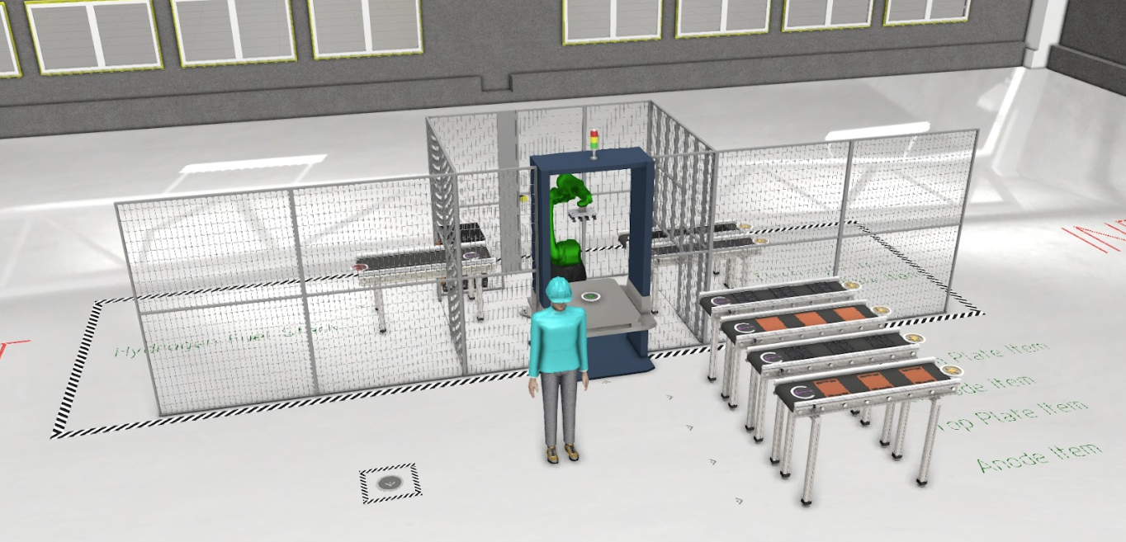
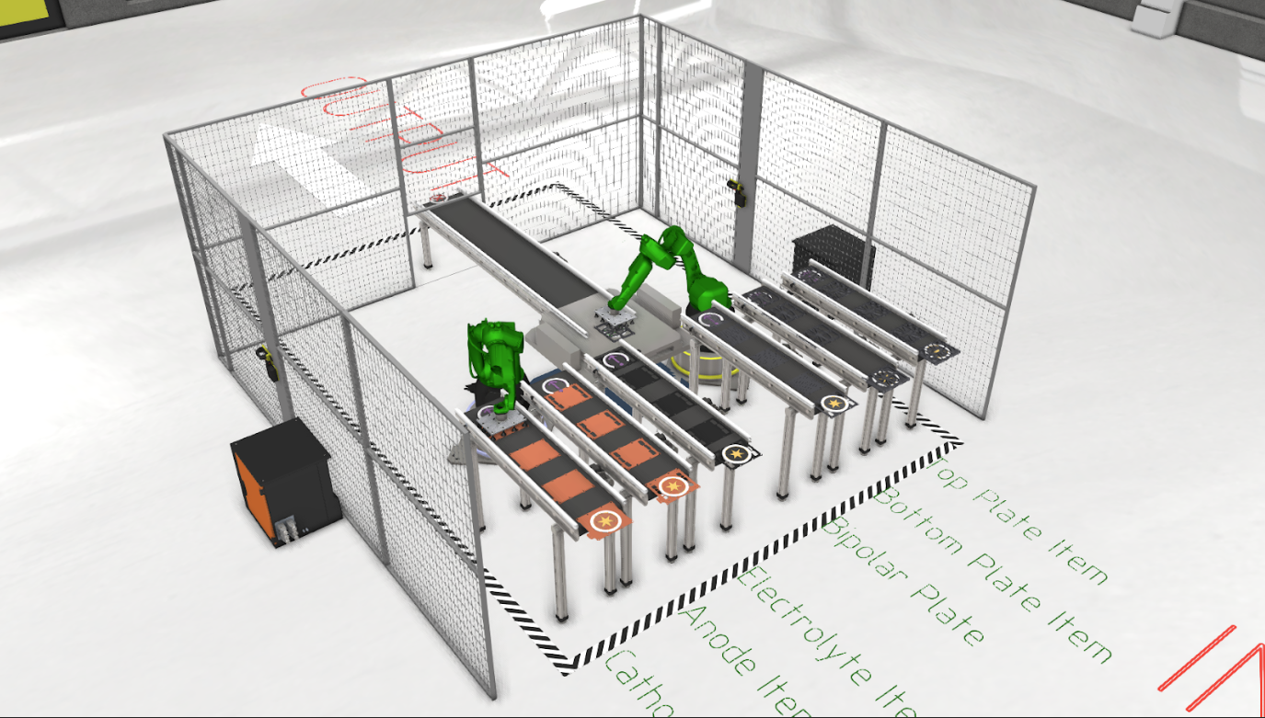
THE OUTCOME
BENEFITS TO THE CLIENT
Commonality assessment report, identifying common components, processes, and operations between electrolysers and fuel cells production systems
Three conceptual designs for automated cell stacking robot systems
Visualisation of reconfigurable and dedicated bi-product factory
Production capacity comparison:
reconfigurable versus dedicated factory
three cell stacking robot systems
Optimised production system design
Quantified benefits and impact from operational digital twin for adaptive scheduling and planning
Cost savings through utilising common resources and components for fuel cell and electrolyser production
Robust robot system design for assembly process automation
Risk reduction for implemented reconfigure factory systems for flexible production of both fuel cell and electrolyser products
Future cost avoidance through virtual analyses and design optimisation
Business case justification and quantification for adopting digital manufacturing solutions
This strategic collaboration between MTC and AMRC showcases how the HVMC centres guide UK manufacturing to meet the future demands for a net-zero hydrogen economy.
Cameron Blackwell – MTC’s Hydrogen Technical Lead
7%
21%
12%
production capacity with
multi-robot cell stacker
production capacity with
optimised system design
production capacity with
adaptive scheduling digital twin
Manufacturing Technology Centre,
Pilot Way, Ansty Park,
Coventry, CV7 9JU
Tel: +44 (0)2476 701 600
www.the-mtc.org

