Slide 1
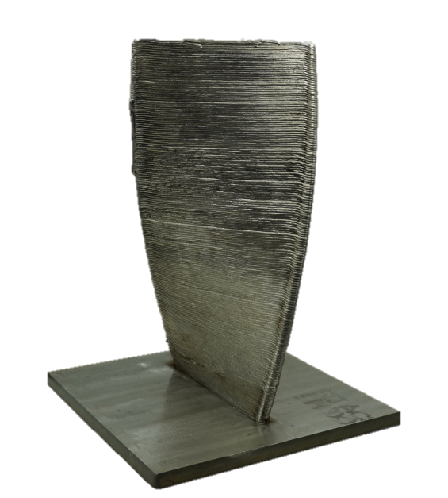
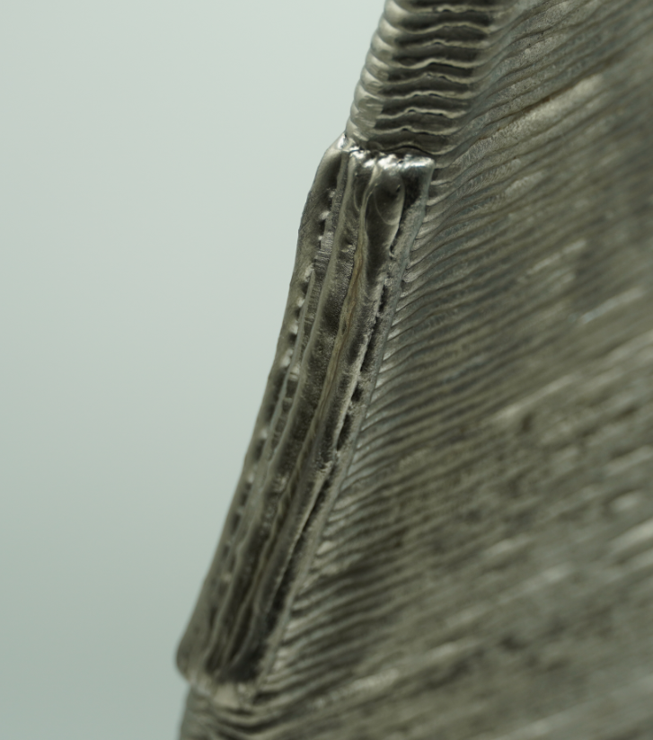
Technology Theme:
LASER PROCESSING / ADDITIVE
SUSTAINABLE MANUFACTURING:
PROCESS MONITORING FOR IMPROVED ENVIRONMENTAL EFFICIENCY
ENVIRONMENTAL IMPACT ASSESSMENT OF DIRECT ENERGY DEPOSITION (DED)
The MTC demonstrated the use of DED for both complex component builds and part repairs through this propeller blade case study. The technologies were assessed on their environmental impact benchmarked against traditional manufacturing methods.
Remanufacturing is a key element to circular economy and the development of processes like DED is a crucial part of that. However, if we do not properly assess these processes they could be as harmful as what they are trying to solve. Therefore understanding how we assess these processes is so important.
Marie Wells, Head of Sustainability, The MTC
THE CHALLENGE
MTC’S SOLUTION
Current casting methods for propeller blade manufacturing generate large amounts of waste. A near net shape DED manufacturing process has the potential to therefore reduce the environmental impact during the manufacturing phase.
Alongside the challenge of building these components, propeller blades are highly susceptible to corrosion in service, limiting their use life to an average of 5 years. DED offers a viable repair mechanism for these parts, providing a means to increase this lifespan, thus reducing the demand for virgin components. However, analysis is required to understand the ‘in process’ environmental impact of this repair method compared to the potential benefits of life extension.
The MTC produced a propeller blade using wire arc additive manufacturing (WAAM), with the build validated against the programmed CAD model using the MTC’s state of the art metrology equipment. During the build, the resources required for the process were monitored providing the necessary information to calculate the environmental impact of the process.
The repair of the blade was then performed using wire fed laser DED, where defects on the leading edge and top edge were accurately repaired (see above images). The environmental monitoring conducted on the build was then repeated on the repair, providing an indication of the life extension required to offset the environmental inputs of the repair.

Slide 2
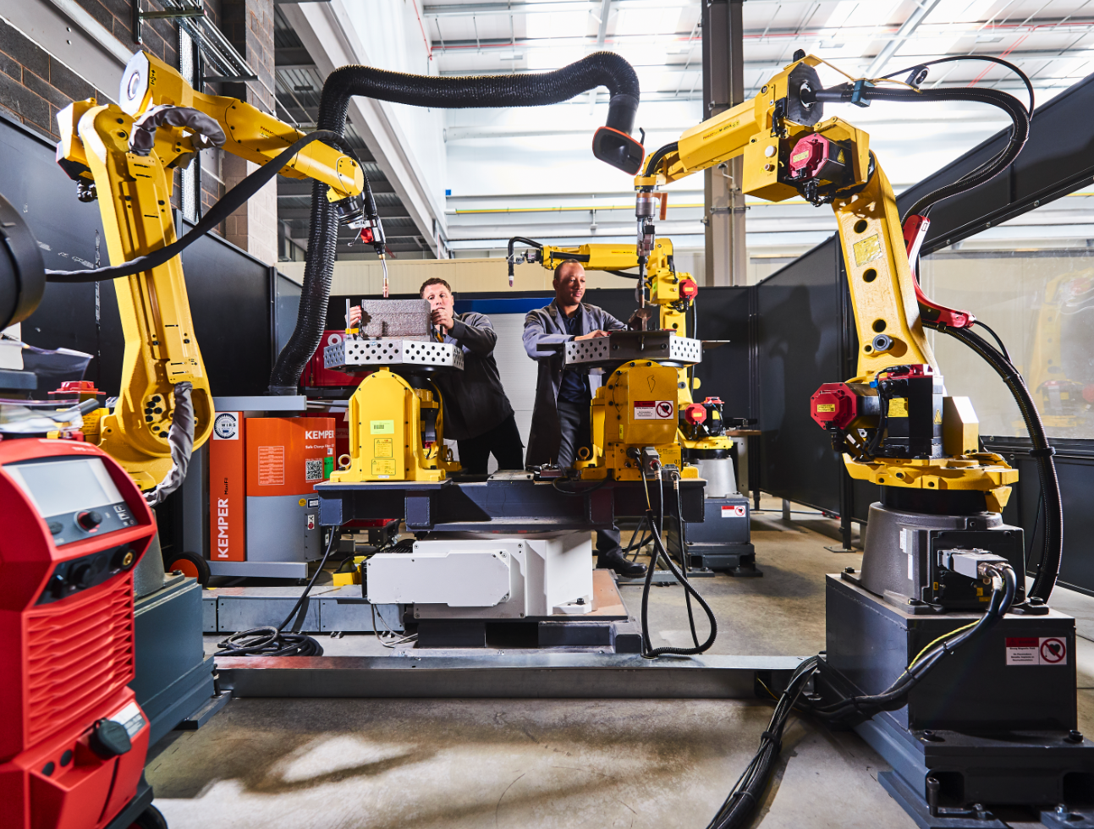
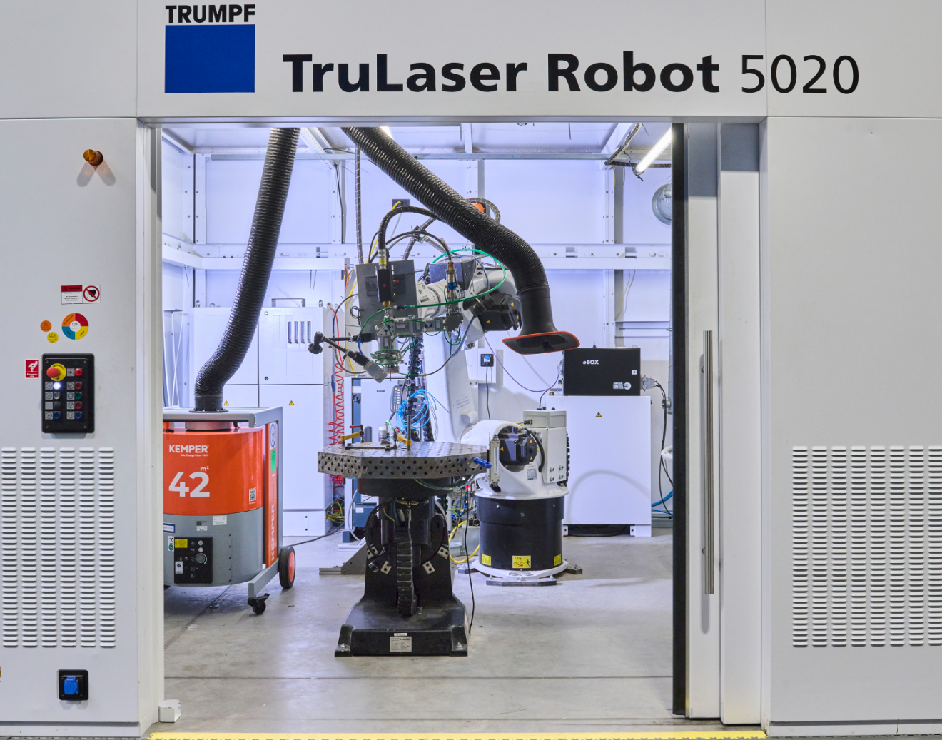
THE OUTCOME
BENEFITS TO THE CLIENT
Near net shape propeller blade manufactured and repaired using wire fed DED processes.
Calculation of the environmental impact of both processes, with identification of ‘hot spots’ where improvements to the process could be made from an environmental perspective.
An end to end methodology for assessing a manufacturing processes environmental impact which can be used across the MTC and industrially.
A business case for the adoption of DED processes for industry to harness both performance and environmental sustainability benefits.
Up to 35% reduction in embodied carbon emissions per propeller blade manufacture through the use of DED compared to investment casting.
Energy efficiency recommendations were made which could reduce the energy consumption of the build process, and in turn reduce the cost of electricity, by up to 73.69%.
Capability to calculate the environmental impact of further manufacturing processes to aid industry in making informed decisions regarding sustainability.
Capability to measure environmental impact for new processes, as well as creation of data to support process selection considering all factors, is a critical capability for MTC to ensure that we support manufacturing industry to produce sustainable outcomes. At MTC we are developing insights through evidence-based methods and this project was a superb example of what we offer.
Dr Justyna Rybicka, Sustainable Manufacturing Programme Lead , The MTC
230%
35%
£20.11
Savings in carbon from repair of component compared to make new and replace
Reduction in embodied carbon using DED for part build compared to casting
Possible saving in energy costs per propeller blade build
Insert Picture
(and supply original image file)
Manufacturing Technology Centre,
Pilot Way, Ansty Park,
Coventry, CV7 9JU
Tel: +44 (0)2476 701 600
www.the-mtc.org

