Slide 1
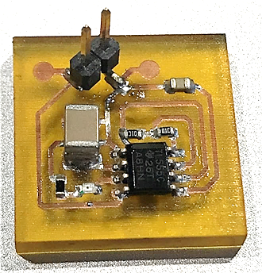
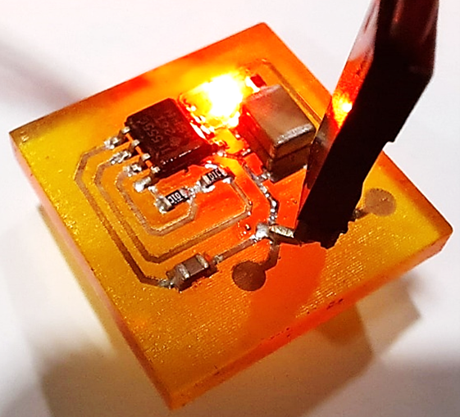
Market Sector:
Technology Theme:
POWER & ENERGY
Industry Leading Laser Technology
Three-Dimensional (3D) Printing of Electronics onto Additive Manufacturing Components
EXPERIMENTAL VALIDATION FOR LARGE INTERFERENCE FITS
The MTC has developed an alternative manufacturing process for 3D printing of electronics that is able to deposit conductive tracks on conformal geometries for common and high-performance 3D printing polymers. The technique utilises an ultra-short pulse laser activation, surface chemical treatment and a conventional electroless plating process.
There is a huge potential for 3D printing of electronics including embedded sensory, customisation, shorter process chains and reduction of material waste. The work completed by the MTC provides a digital manufacturing process which can unleash the UK electronics industry from traditional design constraints and enable the manufacture of connected consumer electronics in the world of the Internet of things.
Reza Nekouie Esfahani, Senior Research Engineer - the MTC
THE CHALLENGE
Conventional manufacturing of electronic systems have limited design freedom and customisation. Additive manufacturing (AM) technique can address these issues but cannot yet achieve the required functionality, miniaturisation and reliability for modern electronic systems.
The laser-based printed circuit board (PCB) manufacturing technique can significantly reduce the processing time/steps while improving the circuitry miniaturisation, design customisability and environmental impact. Such advantages make this technique a robust and reliable candidate for building conformal PCB prototype units with a shorter lead time.

Slide 2
Market Sector:
Technology Theme:
POWER & ENERGY
Industry Leading Laser Technology
MTC’S SOLUTION
The MTC conducted a comprehensive series of trials and investigations to activate the surface of the 3D printable high-performance polymers through laser surface modification and laser surface chemical activation approaches.
Electrical resistivity and adhesion performance of the tracks were tested in the MTC electronics lab and results were in line with the PCB manufacturing industry requirements.
A functional 555 timer circuitry and a conformal antenna design were fabricated using this technique.
Within the UK there is significant capability in manufacturing innovation particularly around power electronics and sensors. This technique further enhances that UK offering. Through projects like this the MTC has de-risked the technology in the hopes to better enable industry adoption into future product designs.
Dr. Marc Henry, Electrification – Sector Development Manager
THE OUTCOME
BENEFITS TO THE CLIENT
Improvement in geometrical design freedom.
Processing of both 3D printed and injection moulded thermoplastic polymers.
Rapid prototyping of industrial embedded electronic systems and Internet of Things.
Enhanced electrical conductivity (compare to other ink-based techniques).
Increased processing speed and productivity.
Reduction in the environmental impact of manufacturing by reducing waste, energy usage, and need for space compared to traditional factory processes.
Introduction and connections to laser system manufacturers to support their projects.
The MTC has enabled the capability for 3D printing of electronics on common, and high-performance 3D printing polymers via two laser-based surface activation solutions:
The Laser Induced Surface Metallisation process which deposits a thin, fast drying, coating of a proprietary precursor material onto a 3D printed part, utilises an ultra-short pulsed laser to selectively activate the precursor into a seed layer followed by an electroless copper plating to form thick conductive tracks.
The second technique focuses on the creation of conductive patterns through laser surface modification of the 3D printed polymer, followed by a surface chemical treatments and subsequent autocatalytic electroless copper plating on the laser surface treated areas.
The global Laser Direct Structuring Antenna market was valued at £1.08 billion in 2022 and is anticipated to reach £2.2 billion by 2029, registering a compound annual growth rate of 10.2%. We believe the laser induced surface metallisation technique can further strengthen the role of the laser direct structuring in this market.
Manufacturing Technology Centre,
Pilot Way, Ansty Park,
Coventry, CV7 9JU
Tel: +44 (0)2476 701 600
www.the-mtc.org

