Slide 1
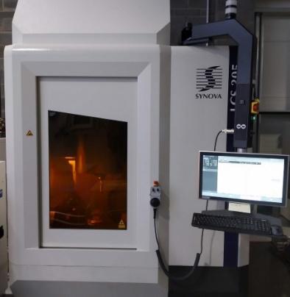
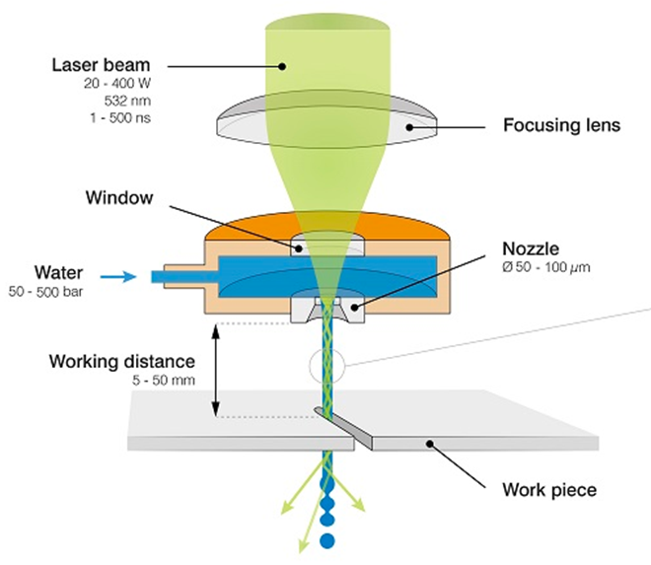
Market Sector:
Technology Theme:
AEROSPACE
Laser Processing
Water Jet Guided Laser Machining of Ceramic Matric Composites (CMC):
VERIFICATION & VALIDATION
EXPERIMENTAL VALIDATION FOR LASER MACHINING OF CMC
The MTC investigated using a water jet guided laser (WJGL) for cutting advanced composites. These materials open up opportunities for improved performance and weight saving in aerospace applications. The MTC showed that high quality cuts with good productivity are achievable using the guided laser.
Synova and the MTC have been pioneers for processing non-traditional materials. Through installing the most advanced machining platform Synova can offer within the MTC, industrial customers can test, validate, and adopt the technology for their most demanding requests.
Jeremie Diboine, Senior R&D Project Leader, Synova
THE CHALLENGE
MTC’S SOLUTION
Ceramic matrix composites (CMCs) are a revolutionary material suitable for a vast range of applications. They are often used in the aerospace sector due to their excellent properties. This includes being very light-weight, capable of withstanding high temperatures with no impact on performance, and high resistance to corrosion and other harsh environments. Due to the composition of CMCs, mechanical tool-based machining can be challenging and inefficient due to excessive tool wear and low processing speeds. Therefore, an alternative manufacturing process is required to improve the quality and productivity that can be achieved when processing these materials. This is essential to enable the application of CMCs in various sectors.
The MTC conducted a series of trials using the state-of-the-art water jet guided laser manufactured by Synova. Cutting trials which varied different process parameters were performed on three CMCs. These were silicon carbide-silicon carbide (SiC-SiC), 3M Nextel Fibre 312 (Al-SiOC) and StarPCS SMP-10 (C-SiOC).
A detailed analysis of the cut quality, including measurements of cut width, entrance and exit width, taper, and heat-affected-zone, was performed. The overall cutting speed was also measured for each cut.
The relationship between each processing parameter, cut quality and productivity was established. This was used to develop the cutting parameters further.

Slide 2
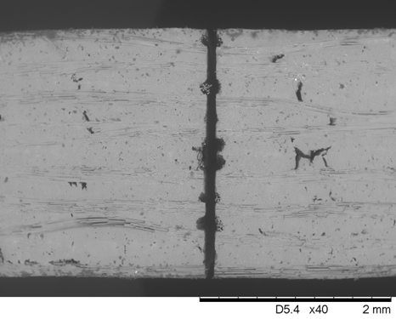
THE OUTCOME
BENEFITS TO THE CLIENT
Suitable process parameters were identified for WJGL cutting of 2 mm thick SiC-SiC, 4 mm thick Al-SiOC, and 4 mm thick C-SiOC.
For each material, a good quality cut at an acceptable processing rate could be obtained using the WJGL. Thermal effects could be minimised through process parameter development.
The cut quality obtainable has negligible cut taper. Overall cutting speeds of up to ~150 mm/min could be achieved for SiC-SiC.
Enabled cutting of CMCs with good quality cut finish, with small heat-affected-zone and no taper.
Improve productivity of CMC machining as compared to mechanical tool machining technique.
By demonstrating the WJGL as a viable machining solution for difficult to machine materials, this provides confidence in the suitability of these materials for the aerospace sector.
The MTC has built an enduring, year long collaboration with Synova to deliver technical and scientific advances beyond the state of the art, with results and publications of the highest standard.
Jeremie Diboine, Senior R&D Project Leader, Synova
150mm/min
3x
20%
Overall cutting speed achievable using the water jet guided laser to cut 2 mm thick SiC-SiC
Less thermal damage compared to conventional laser cutting of the same material
Weight reduction compared to the same aerospace components made from metallics
Figure 1: Scanning electron microscope image of a WJGL cut through 2 mm thick SiC-SiC CMC.
Figure 2: Optical microscope image of a WJGL cut through 4 mm thick Al-SiOC CMC.
Elkington, H., Marimuthu, S., Smith, B. (2022). High Power Water Jet Guided Laser Cutting of SiC/SiC Ceramic Matrix Composite, JLMN. 17 3.
Marimuthu, S., Smith, B. (2021). Laser cutting of ceramic matrix composites, Int. J. Adv. Manuf. Technol. 113, p. 177.
Manufacturing Technology Centre,
Pilot Way, Ansty Park,
Coventry, CV7 9JU
Tel: +44 (0)2476 701 600
www.the-mtc.org

